Slide 1
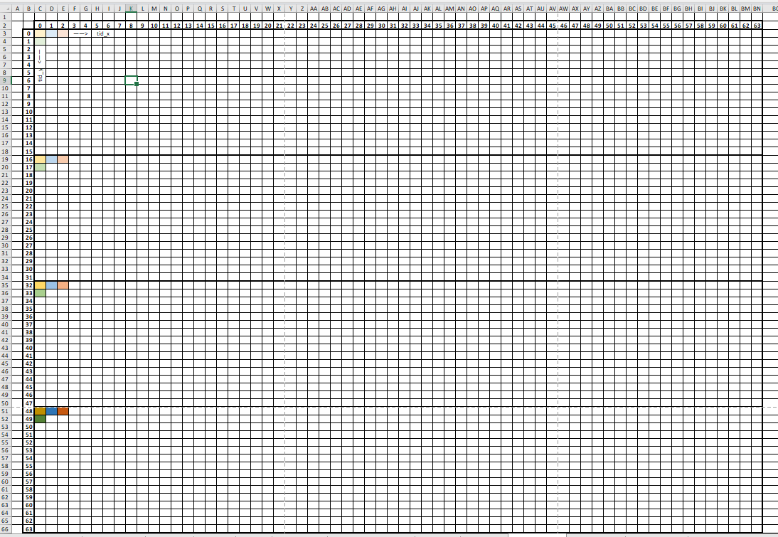
transpose
transpose
Tile transpose
Group size = 64 * 16
Tile = 64 * 64 float2
Transpose one tile per group
Process 4 float2 per thread
Bandwidth = 316.64GB/s vs 1024GB/s

Slide 2
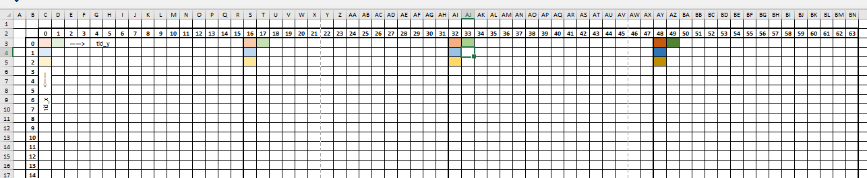
transpose
transpose
LDS usage
4096 float2 (32KB) per group
Write to lds has bank conflict
SQ_INSTS_LDS (18200)
SQ_WAIT_INST_LDS (412915)
SQ_LDS_BANK_CONFLICT (474300)
LDSBankConflict (16%)

Slide 3
transpose
transpose
Reduce bank conflict with padding
Pad one float2 every row (64 float2)
SQ_INSTS_LDS (18200)
SQ_WAIT_INST_LDS (926)
SQ_LDS_BANK_CONFLICT (0)
LDSBankConflict (0%)

Slide 4
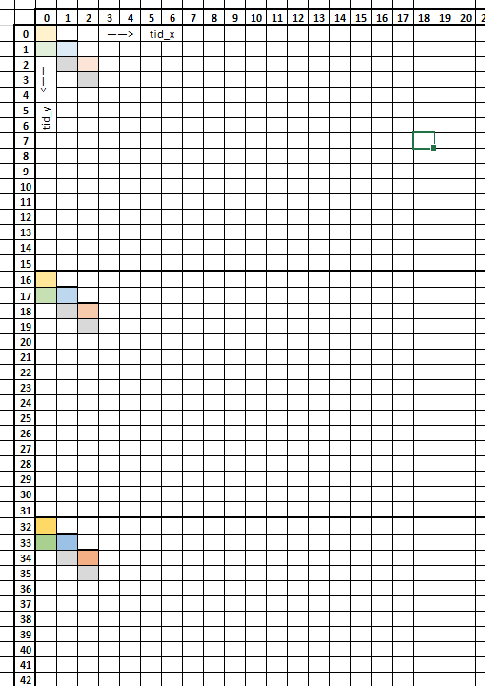
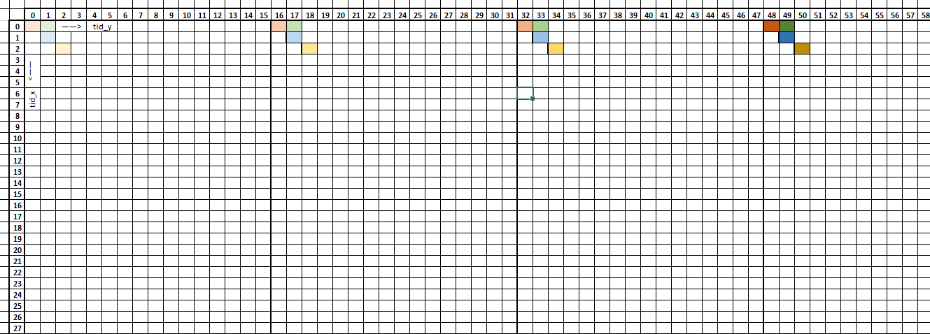
transpose
transpose
Reduce bank conflict by overlap patten
Pad one float every row (float)
SQ_LDS_BANK_CONFLICT (0)
LDSBankConflict (0%)
Lds write
Global read

Slide 5
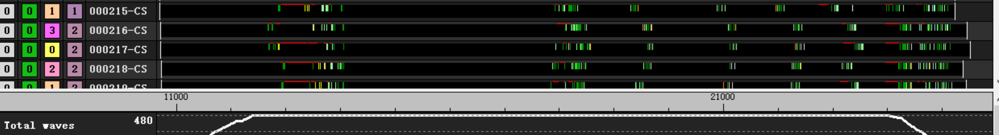
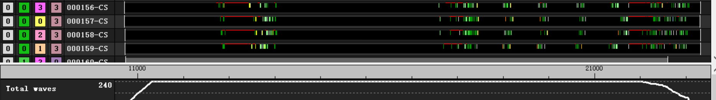
transpose
transpose
Reduce bank conflict with padding
Increase workgroup number
Improve only less than 200 clk

Slide 6
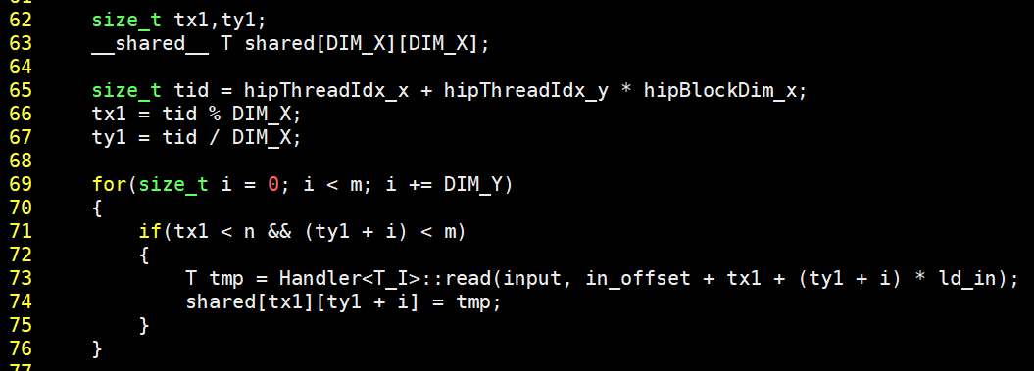
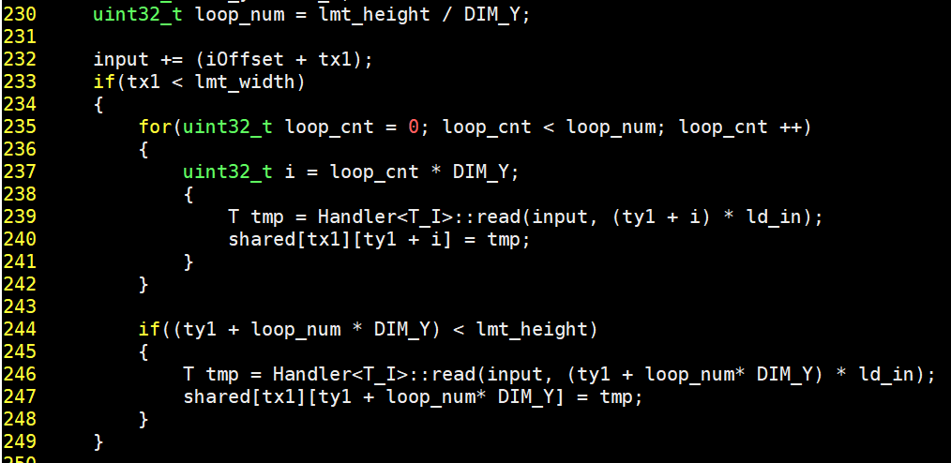
transpose
transpose
Reduce instruction

Slide 7
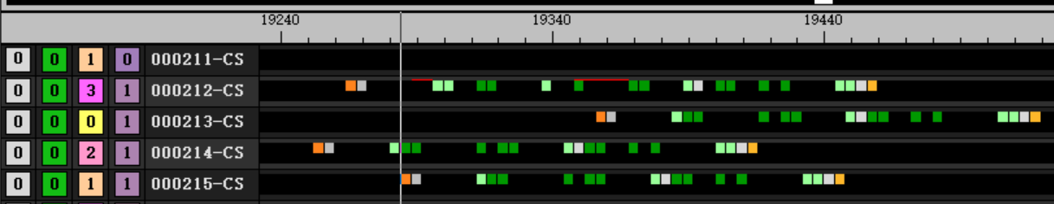
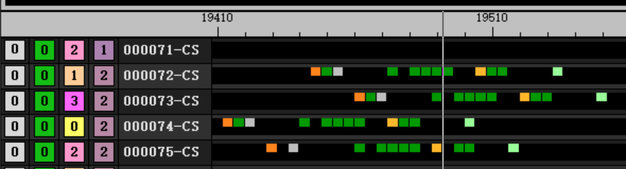
transpose
transpose
Reduce instruction
6salu + 9valu + 3branch → 1salu + 8valu + 1branch
196 clk → 92 clk

